Slide 1
HMM for Robot Localization on a Map Grid
Yifan (Brandon) Yang, Tanush Siotia, Timur Anvar
~Probabilistic Machine Learning~

Slide 2
Introduction
In our probabilistic machine learning class, we have extensively studied Markovian Chains, under-
standing their potential and limitations. HMMs extend this concept by allowing us to deal with
situations where the state of the system cannot be directly observed; instead, we must infer the state
from visible outputs influenced by these hidden states.
To practically explore the utility of HMMs, we have chosen to implement robot localization on a map
grid as our project. This project serves as a bridge between theoretical probability models and their real-world applications, highlighting the versatility and robustness of HMMs in solving practical problems in robotics
and beyond.
Notes:
Allow us to work with situations where we cannot observe the state of the system directly and must infer from the visible outputs influence by these hidden states.
In our case for robot localization in a map grid, we can use it to track the robots interactions with its environment which are not directly observable and are subjet to various uncertainties such as sensor noise and unexpected obstacles

Slide 3
Model Setup

Slide 4
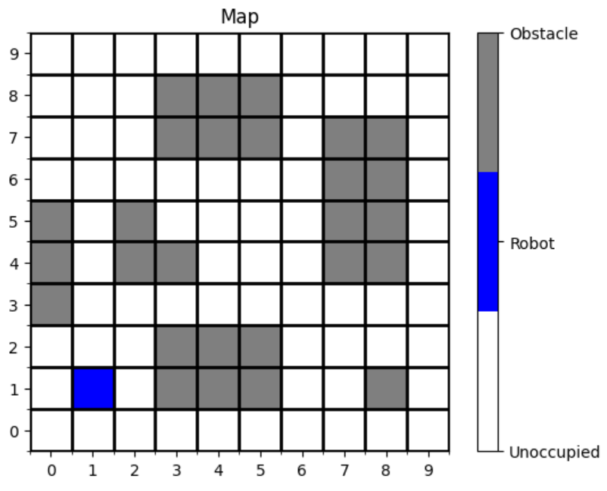

Map Environment
Grid maps break down the environment into a finite set of discrete states. Each cell in the grid represents a possible state that the robot can occupy. This discrete representation aligns well with the structure of HMMs, which are designed to handle discrete state spaces efficiently:

Slide 5

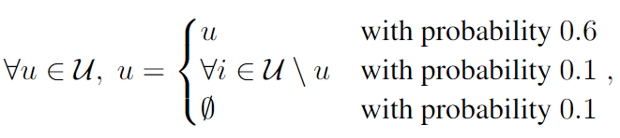
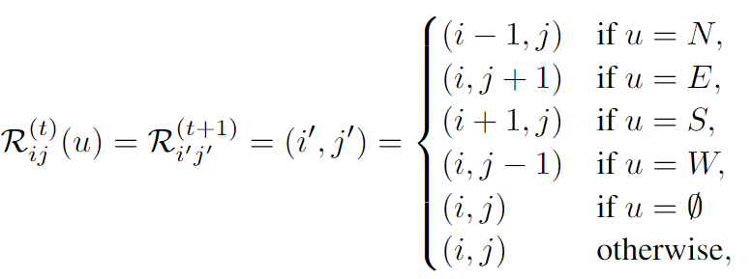
Motion Model
The robot can move in one of the following directions: North, East, West, South.
If a motion commands leads to an invalid state, the robot doesn’t move.
The motion is noisy, so there is a chance the robot will move to a wrong direction.
Notes:
We also define a motion model with predefined actions and their associated probabilities. Our action space consists of U = {N, E, S, W} where each action corresponds to moving the robot agent in
the North, East, South, or West direction, respectively
We add a deterministic noise factor to the motion model to account for the uncertainty in the robot’s movement
For example, suppose we have u = N ,then the robot agent moves North with a probability of 0.6, East, South, or West with a probability of 0.1 each, and stays in the same position with probability of 0.1.

Slide 6
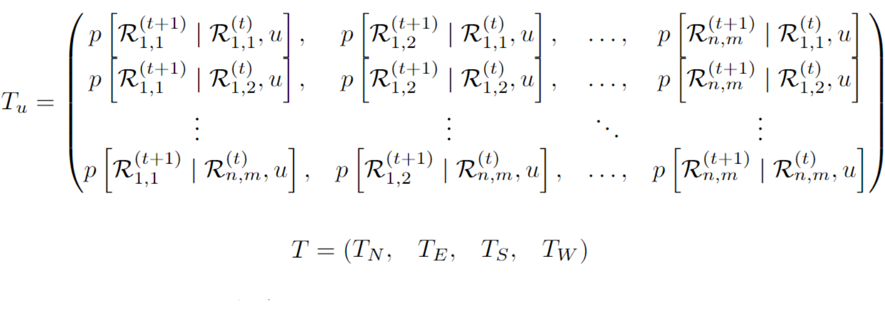
Motion Model, Transition Matrices
The transition matrix contains the probabilities of moving from one state (or grid cell) to another given a particular action. For example, if the robot intends to move forward, the transition matrix will specify the probability of successfully moving forward, the probability of slipping left or right, and the probability of staying in the same place due to an obstacle or slip. Thus, for each of the control inputs u we have to compute a corresponding transition matrix.
Notes:
we also define a transition matrix For each action u ∈ U. T (u)(i, j) =

Slide 7

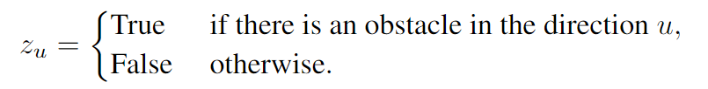
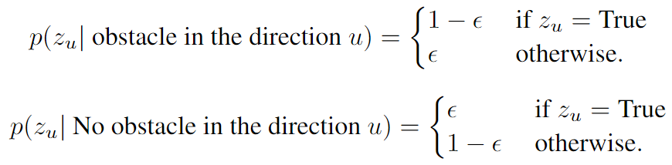
Sensor Model
Our robotic agent is equipped with a (simulated) LiDAR sensor which is highly effective in detecting whether neighboring cells are occupied or free. The sensor achieves this with a 95% accuracy. We can describe our sensor readings as follows:

Slide 8
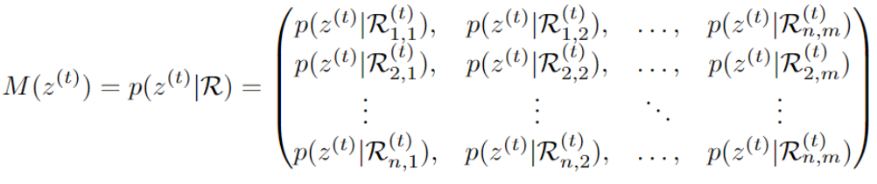
Sensor Model, Observation Matrices
The observation matrix is essentially a probabilistic model that translates sensor readings into the likelihood of the robot being in a particular state. For a robot equipped with a LiDAR sensor, this matrix details the probability of detecting an obstacle or free space in each grid cell relative to the sensor's accuracy.
Each element in the observation matrix corresponds to the probability of receiving a particular sensor reading given the actual occupancy state of a grid cell.
Notes:
the probability of the sensor detecting an obstacle in the direction u given the true state of the map can be modeled as:

Slide 9

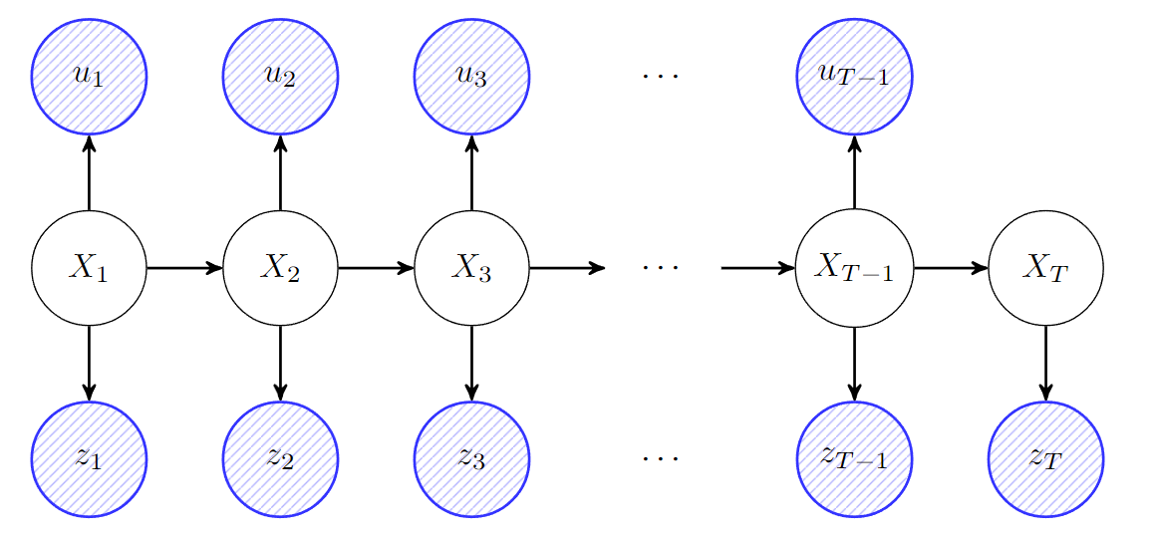
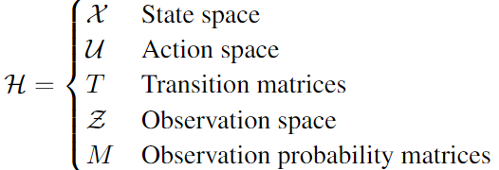
Hidden Markov Model (HMM)
Hidden Markov Models extend the concept of Markov chains by introducing hidden states that are not directly observable. Instead of observing the states directly, we infer the state of the system from visible outputs, which are influenced by these hidden states. This characteristic is particularly useful in situations where direct measurement of the state is challenging or impossible. We can configure our HMM as a tuple

Slide 10
Algorithms

Slide 11
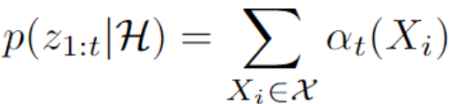

Forward
Initial forward probabilities are computed by multiplying the uniform initial probabilities of the robot being in each state by the probability of observing the first sensor output from those respective states.
Probabilistic Estimation based on the sequence of sensor observations and control inputs received so far.
Adaptability: The forward algorithm adapts to changes in the robot’s environment by updating the belief about its location with each new piece of sensor data.
Termination: At the end of the observation sequence, the total probability of observing the entire sequence given the model is computed by summing the forward probabilities of all states at the final time step:

Slide 12

Backward
Setting Initial Backward Probabilities: At the final time step, the backward probabilities of each state are initialized to 1. This reflects the assumption that there is no future evidence beyond the last observed point, and thus the probability of any future observations given the final state is certain.
Probabilistic Estimation: The backward probabilities provide a way to estimate the influence of future sensor readings on the current state estimation, complementing the forward probabilities which only consider past data.
Adaptability: Like the forward algorithm, the backward algorithm can dynamically adapt to changes in observations, refining future state estimates as new data becomes available

Slide 13
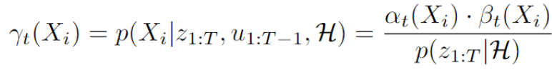
Smoothing
Smoothing refers to the process of calculating the probability distribution over the hidden states at any time step t, given all observed sensor readings and control inputs, from the start to the end of the sequence. This approach allows for a more accurate estimation of the state at any given time by utilizing the full breadth of available data.
This approach is robust to noise and inaccuracies in sensor data, as it integrates information over time, reducing the impact of any single incorrect reading.

Slide 14
Experimental Results + Analysis

Slide 15
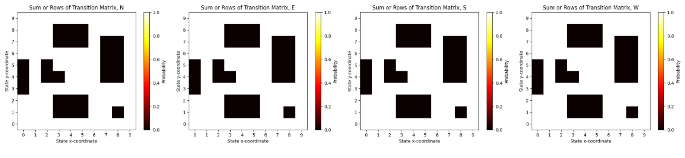
Motion Model, Transition Matrix test.
Each control input u has a corresponding transition matrix. To verify our implementation of each transition matrix, we utilized their total probability property, which states that each row should sum up to one. However, since the robot can neither move to nor move from obstacle states, the rows corresponding to obstacle states should sum up to zero. We plotted these sums below for each direction of movement and confirmed that the resulting plot matches our initial map. Thus, it appears that our transition matrices have been implemented correctly.

Slide 16
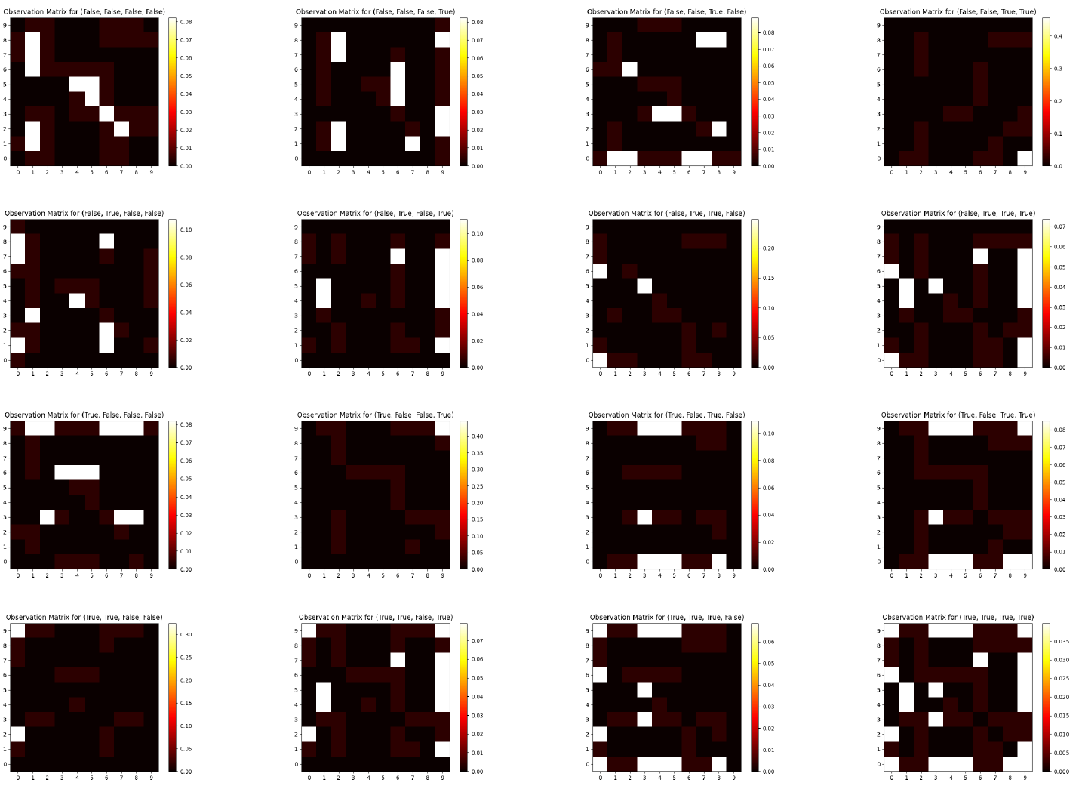
Sensor Model, Observation Matrices

Slide 17
Alpha Probabilities (Forward Algorithm):
Early Stages: Initially low accuracy due to limited historical data.
Over Time: Accuracy improves as more observations are collected.
Beta Probabilities (Backward Algorithm):
Early Stages: Higher initial accuracy with ample future data.
Over Time: Accuracy decreases as future observations diminish.
Smoothing Probabilities:
Combination: Fuses alpha and beta probabilities for each time step.
Results: Provides the most accurate state estimation, closely aligning with the robot’s actual position.
Key Insight: Smoothing consistently offers the most reliable localization by integrating insights from both past and future observations.

Slide 18
Thank You

